Slide 1
Winston-Salem State University Ram Store
About: This project is about an online store for the RAM-store convenience store.
Motivation: One of our team members will be working on an online store after graduation.
Users: Manager, Employee, User

Slide 2

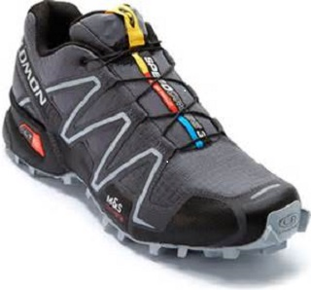
Multiple Products to choose from
Convenient shopping experience & Fair pricing

Slide 3

Use Case
Online Employee
Customer
Orders
Inventory
productName
productsPrice
shoppingCart
Manager

Slide 4
User Interface
What’s Visible to the user and how they will interact

Slide 5

Winston-Salem State University Online Ram Store
Login
Password
Submit
Exit
Forgot Password

Slide 6
Forgot Your Password?
Our Team is considering implementing an e-mail accessed reset.
If this is not achievable there will be a contact phone number to reach the service desk

Slide 7

Manager Responsibility
Ensure Product inventory is accurate.
This will reduce the amount of shrink that the online store generates.

Slide 8
Additional options
We are discussing implementing a not Available notification or sold out at the moment notification to inform the customer.
We also added a shopping cart to give estimate with tax included. The task would be associating the zip code location with the tax applied to that specific State.

